Slide 1
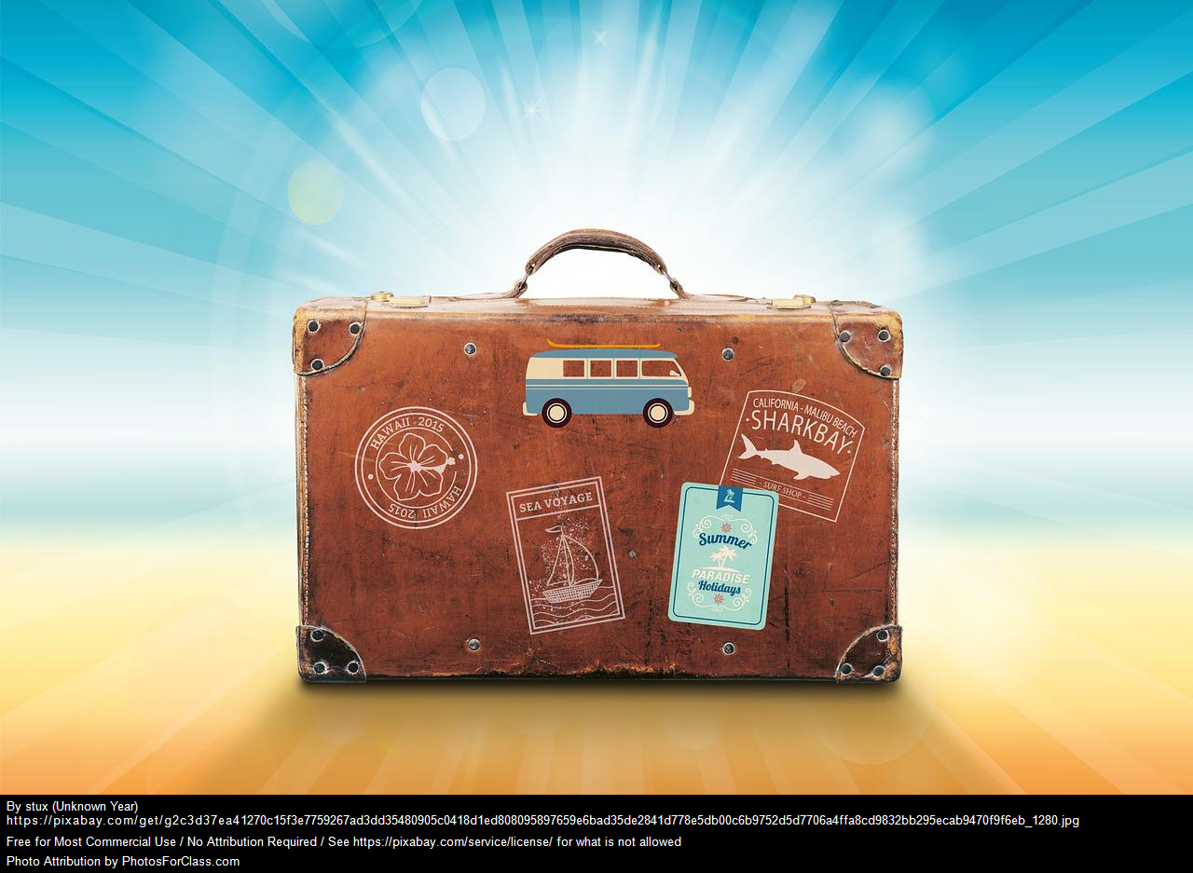
Travel Insurance – Customer Profile and Habits
Chad Brooks
August
2022

Slide 2

Purpose:
Travel Assured has been experiencing major marketing cutbacks of more than 50% due to the COVID pandemic. The advertising budget is very limited, any advertising needs to ensure it is in the right places and in front of the right people.
To assist Travel Assured, they have contracted me to find out the following:
Are there any differences in the travel habits between customers and non-customers?
What is the typical profile of customers and non-customers?
2

Slide 3
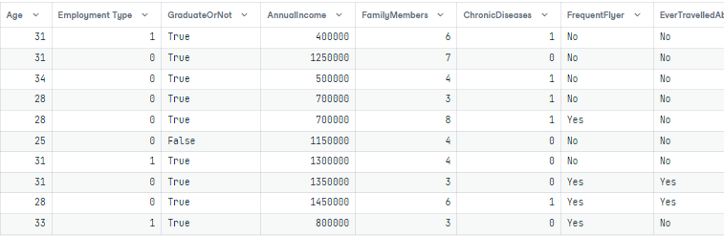
The Data
Travelers Assured provided a spreadsheet with a total of 1,987 entries for customer and non-customer data.
1,277 non-customer entries
710 customer entries
All individuals had the following information:
Age (years)
Employment Type (Government or Private Sector/Self Employed)
Whether the customer is a college graduate ( Yes or No)
Annual Income ($)
Family Members
whether they had a chronic disease (Yes or No)
Frequent Flyer (Yes or No)
Ever Travelled Abroad (True/False)
Have they purchased Travel Insurance.
Traveler
3

Slide 4
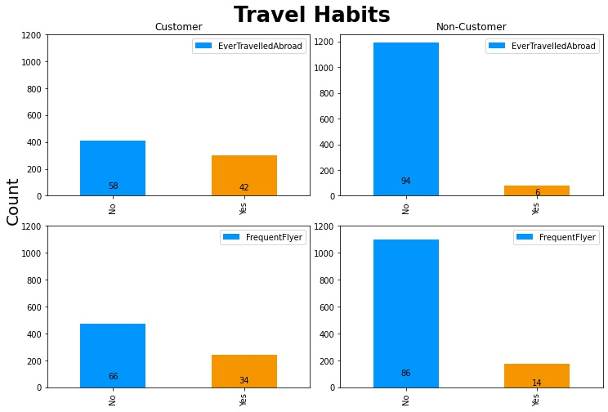
Are there differences in the travel habits between customers and non-customers?
Travel Assured customers are 20% more likely to be a Frequent Flyer and 36% more likely to have travelled abroad than their non-customer counterparts.
There is only 14% of non-customers who are frequent flyers, while 34% of customers are frequent flyers.
There is only 6% of non-customers who have ever travelled abroad, while 42% of customers have.
4
Notes:
Yes, Travel Assured customers travel habits are more frequent and widespread than that of non-customers.

Slide 5
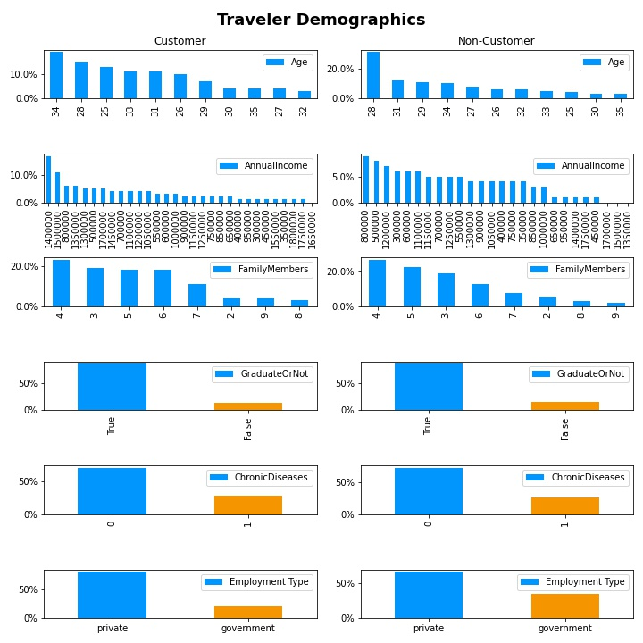
What is the typical profile of customers and non-customers?
Let’s look at the similarities between customers and non-customers first:
Family sizes for both groups fall between 3-5 family members on average.
Most individuals have graduated from a college/university
Many of the individuals are in the private/self employed sector (non-customers are 14% more likely to be in the government sector)
Chronic Diseases are not common among either group (71% customers without chronic disease vs 73% non-customers)
5
Notes:
@ End of Slide = Now that the similar features have been identified, let’s take a deeper dive on the profile of customers and non-customers based on Age and Income.

Slide 6
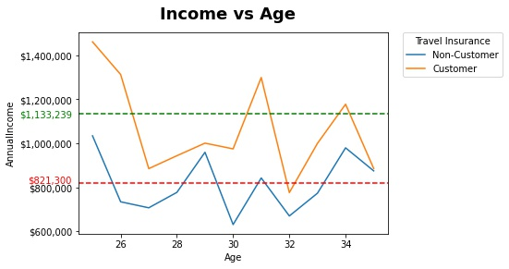
Customer and Non-Customer Income Vs. Age
Based on the data, Travel Assured customers tend to have higher income and be a little bit older than non-customers.
Customers on average make around $1,133,239 yearly, while the non-customer group only makes $821,300 yearly. A total average difference of $311,939
6
Notes:
Customers in every age group outpace non-customers when it comes to annual income. The only age group that is close, is the last age group of 35 years old.

Slide 7
Recommendations
Run a contest for Frequent Flyers and Travel Abroad customers to get them engaged and act as a reminder for the product.
Move marketing campaigns to affluent family friendly neighborhoods to target higher income individuals.
Introduce a travel App that includes guidance and updates on the current state of the world and how to safely navigate travelling post-pandemic.
7
Notes:
1st Recommendation - The contest could be as simple as customers providing advice on how to travel safely during COVID and how to travel sustainably to ensure destinations locations to not only keep the environments clean but support the communities in these areas as well. A small prize or international flight could be offered as an incentive.
2nd Recommendation - This would be a solution to ensure the budget is getting in front of the right eyes at least until pandemic woes ease and budgets can be increased again.
3rd Recommendation - This could include best local cuisine, food and water safety, travel checklists, vaccination requirement and more. The app can even be targeted to be only for those who purchased or have purchased insurance. When someone purchases and downloads the app, the app could have options for real time agent connect for questions or have push notifications sent about their destination

Slide 8
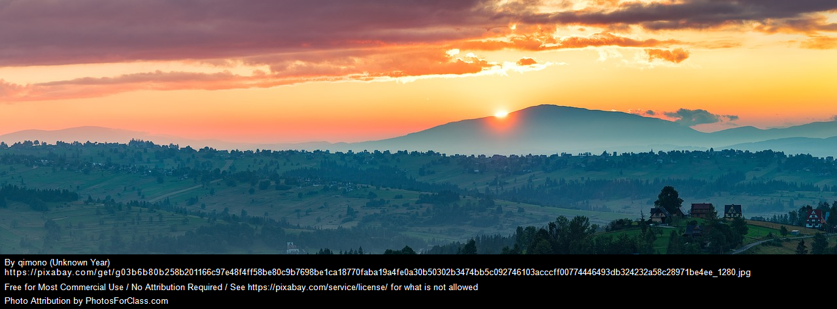

Summary
Customer/Non-Customer Travel Habits:
Exploring the data let us know that customers are more likely to be Frequent Flyers and Travel Abroad than non-customers for travel insurance.
Customer/Non-Customer Profiles:
Customers tend to be individuals who graduated college and are in their 30s with income around $1,100,00.00. Customers also typically have families of 3-5 members, no chronic diseases, and work in the private/self employed sector.
Non-Customers are individuals who graduated college and are also in their 30s, however, their income is lower and around $821,300.00. Non-Customers also typically have families of 3-5 members, no chronic diseases, and work in the private/self employed sector.
8

